Slide 1
Billing – Common Workflows
Steven Bradley

Slide 2
Session Content
Billing Page
Billing Configurations
Charge Custom Views
Static Views to Monitor Encounters
Search eSuperBill
Flexible view to Monitor Encounters
Denials
Processing/ Correcting Denied Encounters
Financial Overview
Monitoring Billing Health of Practice
Fee Schedule
Create New Fee Schedules for Updates
Sliding Fee Scale
Linking to Fee Schedules
Program Codes
Updating to Include New SFS

Slide 3
Custom Charge View
Creating a Custom Charge View
Using the Custom View
Add new eSuperbill view with timeframe of encounters
Status of Signed, Unsigned, and Not Created
Note type of All, or optionally can use this to filter out certain encounter types
Select an encounter to work on by clicking date
Create your charge from eSuperbill
Once charge is created (Saved) encounter will fall off of view

Slide 4
eSuperbill Search

Slide 5
Financial Overview
Allows to view outstanding items for entire Practice
Allows for drilling down to review/ manage specific encounters by payer
Practice View
Payer View
Charge View

Slide 6
Practice View

Slide 7
Payer view

Slide 8
Charge View

Slide 9
Denial Processing
Post Claim
Work Denial By Code
Writing Off Vs Resubmission
Claim/ Charge Editing
Resubmission

Slide 10
Posting Denial
Denials must first be posted in order to move them to the denial area of the application

Slide 11
Work Denial by Code Pt 1

Slide 12
Working Denial by Code Pt 2

Slide 13
Writing Off Vs Resubmission

Slide 14
Writing Off Vs Resubmission

Slide 15
Claim/ Charge Editing

Slide 16
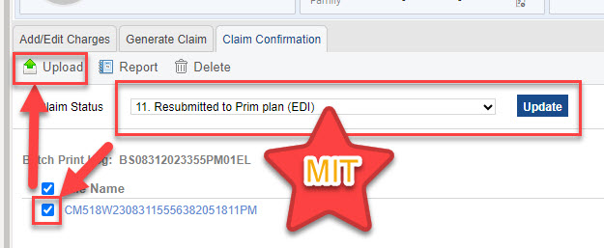
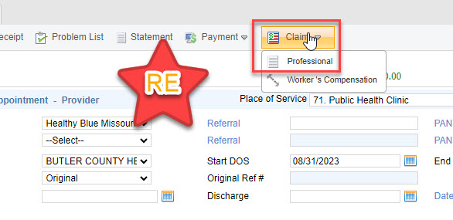
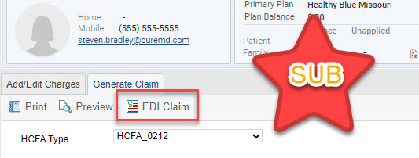
Resubmission

Slide 17
DIY Billing Configurations
Fee Schedule
Create New Fee Schedules for Updates
Sliding Fee Scale
Linking to Fee Schedules
Program Codes
Updating to Include New SFS

Slide 18
Fee Schedule Updates

Slide 19
Sliding Fee Scales

Slide 20
Program Code Updates

Slide 21
Questions

